Slide 1
Water level monitoring system
BATCH-7

Slide 2
GROUP MEMBERS
RAMA KARTIKEYA 2003A52065
BOLUKONDA VAMSHI 2003A52022
MOHD AFROZ 2003A52102
PANUGANTI NISHWITH 2003A52128

Slide 3
Abstract:
As people are busy in doing their daily chores it becomes difficult to track water level in the tanks situated at their home’s rooftop. And as tanks are located on top of most of the houses the individual need to go up and downstairs. During which wastage of water happens. So to solve this issue we have made a Water-Level-Monitoring-System using ESP32 and Ultra-Sonic Sensor (HC-SR04). Water is an essential need. So, not only monitoring it can also be used to stop water wastage.

Slide 4
Introduction
Over the past years, people are unable to trace the water quantity in the water tankor container. Even by not tracing water level in the tank there is other issue of water flow after its full, causing the water wastage. Water is one of the most valuable and important resources on planet. Energy conservation in the tank level water monitoring system is defined in this project using an Internet of Things (IOT) based idea. The major goal is to have a sensor that monitors the water level and should inform the user of the amount of water that is currently in the tank.

Slide 5
Problem Statement
Need of this project is to avoid wastage of water. Because sometimes people forget to off the motor when tank is full, because of that water get wasted. To avoid this problem this project came into picture. By using this water level indicator system we can monitor water level and consumption of water.

Slide 6
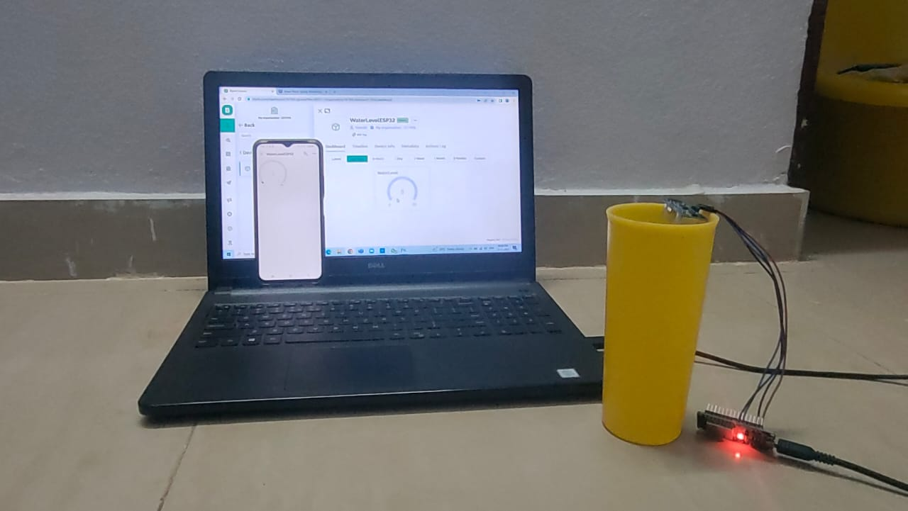
Hardware Implementation
The main hardware components used in the project are
ESP32 DEVKIT V1
ULTRASONIC SENSOR
(HC-SR04)

Slide 7
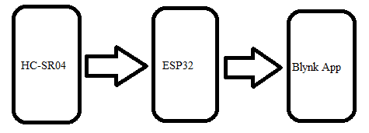
Block Diagram

Slide 8
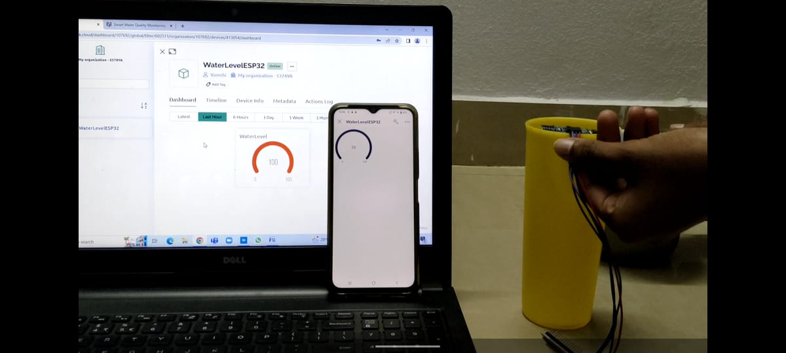
Working Model:

Slide 9
Conclusion:
The IOT-enabled water level monitoring system is completed using the parts, using blynk application we can monitor the water tank level. The framework may be developed and distantly created with more sensors. With the aid of sensors and equipment components, we can protect the water by reducing wasteful water use and electricity consumption. Additionally, this particular application is useful for small businesses and homes. Finally, the project that only required a few simple components was completed, making it efficient and cost-effective.

Slide 10
References:
[1] Mohit Parashar, Roopa Patil, Siddharth Singh, Vipul Vedmohan, & K.S Rekha. (2018). Water level Monitoring System in Water Dispensers using IOT. IRJET, 05(04), 1217-1220.
[2] Divya Kaur. (2016). IOT based water tank control.Article-Embedded for You.
[3] B.Dhivapriya, C.Gulabsha, S.P.Maniprabha,G.Kandasamy, & Dr. V.Chandrasekaran. (2016). GSM based water tank level monitoring and pump control system. IJARMATE.

Slide 11
THANK YOU

